Slide 1
Uncovering “Jury Tariffs” in the US Justice System
Charlie Yaris
Notes:
Today I’m going to talk about trial penalties in the US justice system and see if I can find evidence for a concept known as a “jury tariff.”

Slide 2

The “Jury Tariff”
''Not having a jury trial can save a lot of time and effort. Pragmatically speaking, it’s necessary and it’s justified to give a guy a tougher sentence if he takes more time and burdens the system.’’
– Anonymous Cook County Judge
Quoted in the Chicago Tribune, 1985
Notes:
What is a jury tariff?/Why might this discrepancy exist?
Jury tariffs are the price defendants pay in increased sentences when they take their case to trial instead of pleading guilty.
We expect the same penalty for the same crimes, but the jury tariff suggests this is not the case.
The Illinois Supreme Court has ruled on several occasions that the accused cannot be punished for electing to have his case decided by a jury.
We shouldn’t be finding this discrepancy because it’s unconstitutional!
Some judges and lawyers in Chicago say the jury tariff is needed to keep the court system here from becoming staggeringly backlogged with cases awaiting jury trials.

Slide 3
93%
of Sentences are the Result of a Guilty Plea
Notes:
In Cook County!
That means 6.9% were found guilty by a jury in trial.
Trial by jury is guaranteed by the 6th Amendment to the U.S. Constitution.

Slide 4
Why do so many defendants plead guilty?
Conviction Type | Avg Years Sentenced
Plead Guilty | 2.8 Years
Found Guilty by Jury | 7.1 Years
Notes:
…as opposed to opting to go to trial.

Slide 5
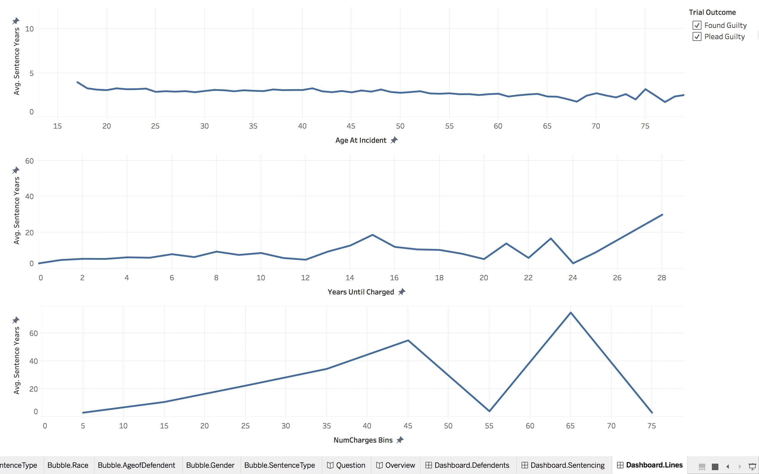
Notes:
High variance in found guilty, but also higher sentences on average.

Slide 6
Predicting the “Jury Tariff”
Can we predict whether a defendant plead guilty or was found guilty by a jury?
Notes:
(based on the features we would have at the start of a case).

Slide 7

148,703 Guilty Sentences from Cook County, IL
Sentences from 2014 – 2018
Start-of-Case Features
Defendant: Age, Race
Charge: Number of Charges, Criminal Class
Sentence: Phase, Type, Length

Slide 8
Model: Logistic Regression
Chosen for Prediction Accuracy on Guilty Verdicts
Model Accuracy: 84%
Guilty Plea Precision: 96%
Guilty Verdict Precision: 20%

Slide 9
Conclusion
Visualizations depict major differences in sentence length.
Current model not strong enough to predict conviction type.
Counsel data could improve future model performance.
Notes:
3. private attorney or a public defender

